Slide 1
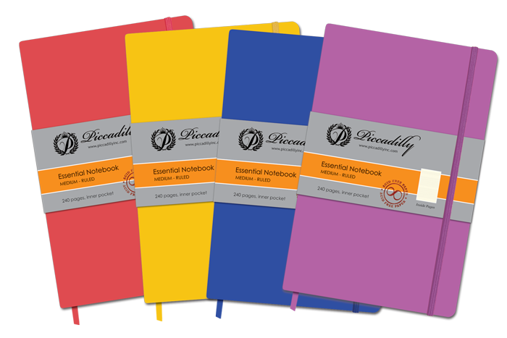
How to Write your Chapel Notebook (Remix)

Slide 2
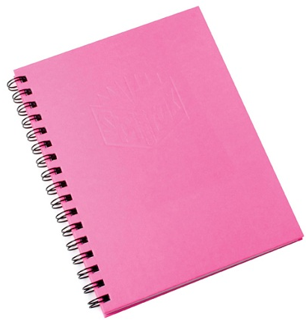
Starting
Have a separate notebook for your Chapel notes. This notebook should be for chapel notes only!
Write your name and grade on the outside of the notebook.
CHAPEL
NOTEBOOK
LIKE THIS!!!!
JANE LEE
GRADE 13

Slide 3
Heading
Write your name and the date on the top of the paper.
Write the message title and Bible verses used/or Topic
Matt. 5:1-11
Jane Lee
8/21/15
LIKE THIS!!!!
Beattitudes

Slide 4
Body
5. Write down 5 things you have learned or heard during chapel time—even if it is about a university or school rules. It may be a bullet point list.
Matt. 5:1-11
Jane Lee
8/21/15
Beattitudes
Mr. Huh said don’t chew gum in class
Jesus loves everyone and wants to save them from hell
Blessed are the peacemakers
Wheaton College is the best school ever!
Biola is in California
LIKE THIS!!!!

Slide 5
Extra
6. Chapel notebooks are due on Friday at 4pm.
All chapel journals need at least 5 bullet points from chapel and the date

